Slide 1
Stochastic Convergence
Jaehyoung Hong

Slide 2










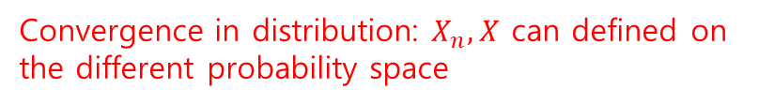
Basic theory: Three types of convergence of random vectors
Definition: Random vector in $ℝ^{k}$ is a vector $X=(X_{1},…,X_{k})$ of real random variables.
Definition2: The distribution function of $X$ is the map $x↦P(X≤x)$.
Converge in distribution
(Weak convergence, Convergence in law)
Converge in probability
$$P\left({d(X}_{n},X\right)>ε)→0$$
$$P(X_{n}≤x)↦P(X≤x)$$
for all $ε>0$
where $d(x,y)$: distance function on $ℝ^{k}$.
for every $x$ at which the limit distribution function $x↦P(X≤x)$ is continuous
Notation: $X_{n}\underset{→}{P}X$ or $d(X_{n},X)\underset{→}{P}X$
Notation: $X_{n}⇝X$,
$X_{n}⇝L$ (where $X$ has the distribution function $L$)
Converge almost surely
$X_{n}$: A sequence of random vectors
$$P\left(lim⁡{d(X}_{n},X\right)=0)=1$$
Notation: $X_{n}\underset{→}{as}X$
Convergence in distribution: $X_{n},X$ can defined on the different probability space
$X_{n}$: A sequence of random variables

Slide 3
Classical example
Let ${\overline{Y}}_{n}$ be the average of the first $n$ of a sequence of independent, identically distributed random vectors $Y_{1},Y_{2},…$.
If $E\left\|Y_{1}\right\|<∞$, then ${\overline{Y}}_{n}\underset{→}{as}EY_{1}$ by the strong law of large numbers
+ $E{\left\|Y_{1}\right\|}^{2}<∞$, then $\sqrt{n}\left({\overline{Y}}_{n}−EY_{1}\right)⇝N\left(0,CovY_{1}\right)$ by the central limit theorem

Slide 4
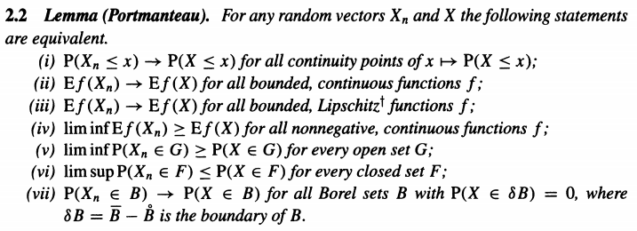








Portmanteau lemma: Equivalence of weak convergence
Weak convergence
Trivial
$$B=(−∞,x)$$
1
$$⇒$$
2
$$⇒$$
3
$$⇒$$
5
$$⟺$$
7
$$⇒$$
1
Trivial
$$⟺$$
$$⟺$$
4
6

Slide 5
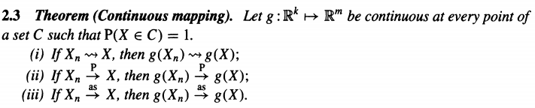
Continuous mapping theorem: We can apply many transforms to convergence sequence
(1): Portmanteau lemma (5) and (6)
(3): Trivial

Slide 6
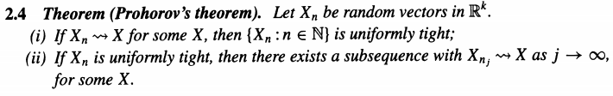
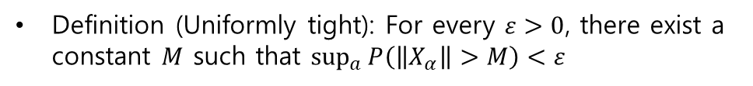


Uniformly tight (Bounded in probability)
Definition (Uniformly tight): For every $ε>0$, there exist a constant $M$ such that $\sup_{a}{P\left(\left\|X_{α}\right\|>M\right)<ε}$
$$⇒$$
Weak convergence
Uniformly tight
$$⇒$$
Almost (Subsequence)

Slide 7
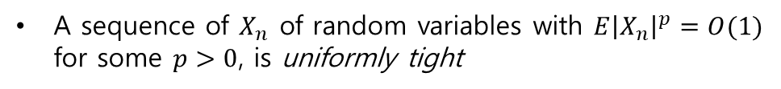
Example of Uniformly tight sequence
A sequence of $X_{n}$ of random variables with $E{\left|X_{n}\right|}^{p}=O(1)$ for some $p>0$, is uniformly tight
Proof. Markov’s inequality $P\left(\left|X_{n}\right|>M\right)≤\frac{E{\left|X_{n}\right|}^{p}}{M^{p}}$.

Slide 8
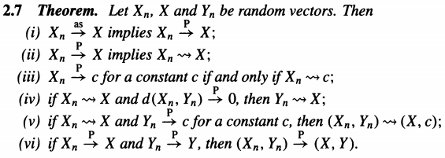
The relationships among the three modes of convergence
Weak < Probability < Almost surely
Weak = Probability (If the limit is constant)
Convergence in probability: $X_{n}=\left(X_{n,1},…,X_{n,k}\right)=X_{n,i}$ each
Convergence in distribution: $X_{n}=\left(X_{n,1},…,X_{n,k}\right)≠X_{n,i}$ each

Slide 9
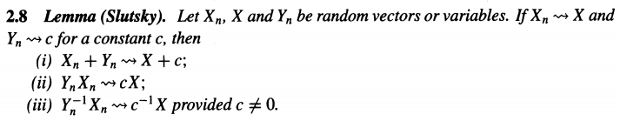
Application of Thm2.7 (v)
For (ⅱ), (ⅲ), $c$ can be vector or matrix

Slide 10
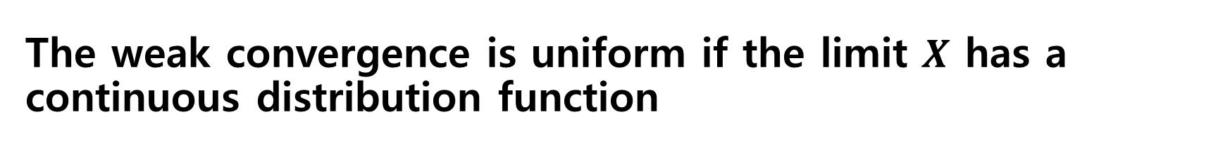
The weak convergence is uniform if the limit $X$ has a continuous distribution function

Slide 11


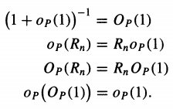
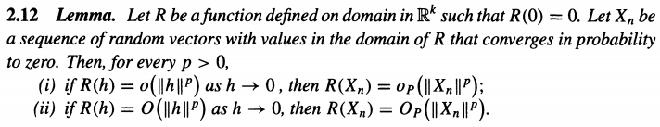
Stochastic o and O symbols
Converges in probability
Bounded in probability

Slide 12
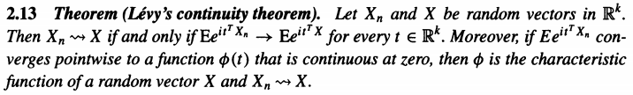
Levy’s continuity theorem: Pointwise convergence of characteristic functions is equivalent to weak convergence
Characteristic function: $t↦Ee^{it^{T}X}$, $t∈ℝ^{k}$

Slide 13
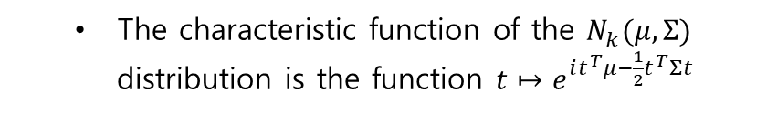

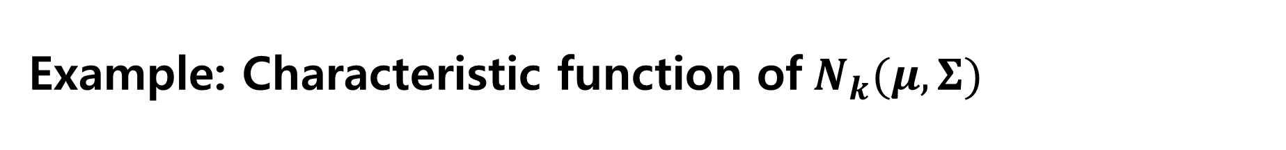
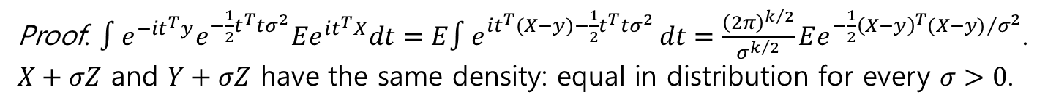
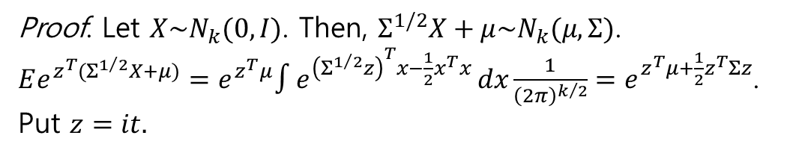
Example: Characteristic function of$N_{k}(μ,Σ)$
The characteristic function of the $N_{k}(μ,Σ)$ distribution is the function $t↦e^{it^{T}μ−\frac{1}{2}t^{T}Σt}$
Proof. Let $X\sim N_{k}(0,I)$. Then, $Σ^{1/2}X+μ\sim N_{k}(μ,Σ)$.
$Ee^{z^{T}(Σ^{1/2}X+μ)}=e^{z^{T}μ}∫e^{{\left(Σ^{1/2}z\right)}^{T}x−\frac{1}{2}x^{T}x }dx\frac{1}{{\left(2π\right)}^{k/2}}=e^{z^{T}μ+\frac{1}{2}z^{T}Σz}$.
Put $z=it.$
Proof. $∫e^{−it^{T}y}e^{−\frac{1}{2}t^{T}tσ^{2}}Ee^{{it}^{T}X}dt=E∫e^{{it}^{T}(X−y)−\frac{1}{2}t^{T}tσ^{2} }dt=\frac{{\left(2π\right)}^{k/2}}{σ^{k/2}}Ee^{−\frac{1}{2}{{\left(X−y\right)}^{T}(X−y)}/{σ^{2}}}$.
$X+σZ$ and $Y+σZ$ have the same density: equal in distribution for every $σ>0$.
$${\left(2π\right)}^{k}p_{X+σZ}(y)$$

Slide 14


Example: Simple proof of weak law of large number and central limit theorem
“if’ part becomes simple.

Slide 15
Cramer-Wold device and reduction of high-dimensional problem
Cramer-Wold device
Weak convergence is maintained for linear transform ($≒$embedding)
Although $Y_{i}$ becomes random ‘vector’, our proof is suffice to prove in 1D.

Slide 16
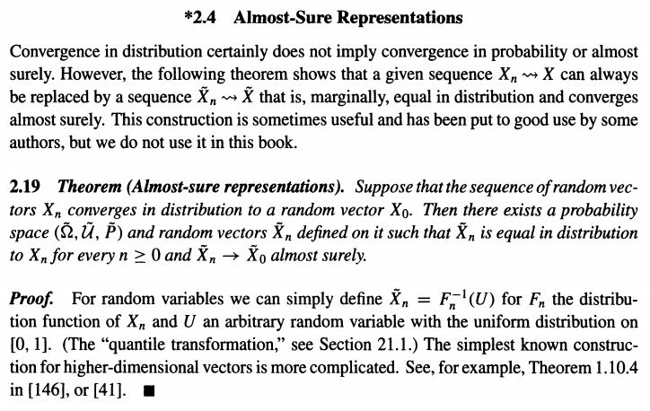
Almost-sure representations
We can make any weak converged sequence as almost surely converged sequence

Slide 17


Asymptotically uniformly integrable: To make “moments” converge
Asymptotically uniformly integrable
$$\lim_{M→∞}{\underset{n→∞}{limsup}{E\left|X_{n}\right|1\left\{\left|X_{n}\right|>M\right\}=0}}$$
“Thin” tail
$X_{n}⇝X$ and $\operatorname{limsup}{E{\left|X_{n}\right|}^{p}<∞}$ for some $p$ $⟶$ $EX_{n}^{k}→EX^{k}$ for every $k<p$.

Slide 18
Limit distribution is uniquely determined by its moments, moment convergence implies weak convergence

